Slide 1



Course Project 1: Subfamily classification of glycoside hydrolase family
Siva Shanmugam (Postdoc)
Xinpeng Zhang (PhD student)
Yi Xing (Master student)
Department of Food Science and Technology
10/24/2024
PI: Yanbin Yin
Notes:
Hello everyone and we'll talk about the project today about Subfamily classification of glycoside hydrolase family. All tools and scripts are given by our postdoc Dr. Siva and I will go through all the parts and provide some hands-on demonstration.

Slide 2
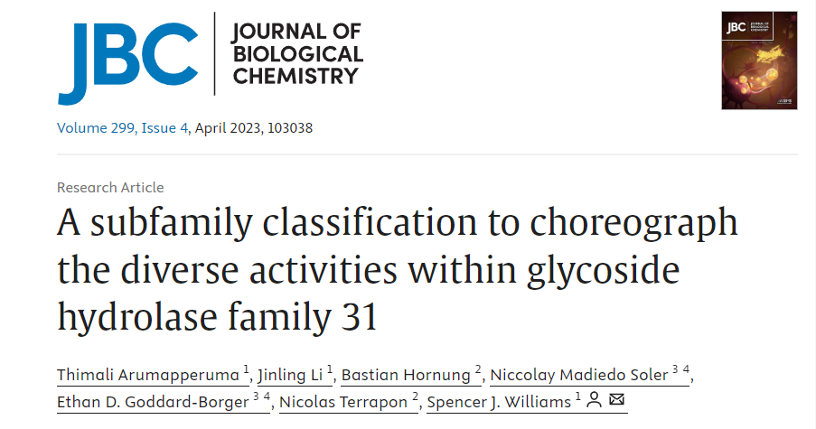
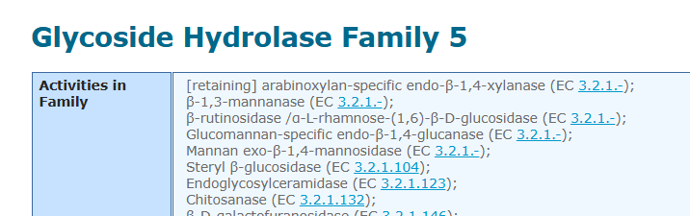
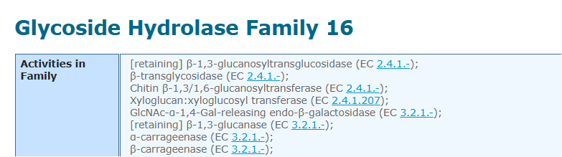
Introduction
Goal: Classify the CAZy family into subfamilies, analyze and visualize them using Bioinformatics tools and methods.
In this project, we will do CAZyme subfamily classification following the paper:
DOI: https://doi.org/10.1016/j.jbc.2023.103038
We will use GH31 as an example to show all analyses
Students will form two groups to work together on GH5 (group 1) or GH16 (group 2)
Notes:
we will be focusing on classifying the CAZy family into subfamilies. and to analyze and visualize them using bioinformatics tools and methods.
For this project, we are going to follow the methodology outlined in this paper
To give you a clearer picture, we'll be using GH31 as our primary example to demonstrate all the analyses we'll perform.
GH31 is a diverse and well-studied glycoside hydrolase family
Now, we need to divide the class into two groups. Group 1 will be working on GH5, another important glycoside hydrolase family, while Group 2 will focus on GH16. Each group will apply the classification and analysis techniques we discuss today to their assigned family.

Slide 3
Outline
1. Data preparation
2. Domain annotation
3. Domain extraction
4. Sequence similarity networks (SSNpipe)
5. Cytoscape Visualization
6. Phylogenentic Analysis
7. Other analysis
Notes:
/ɪkˈstrækʃ(ə)n/
/ˌfaɪloʊdʒəˈnetɪk/

Slide 4
Part I Data preparation

Slide 5
1.1 - Create Project Folders and Clone Git Repository
Log in your swan OnDemand and download all data to the work folder.
cd $WORK
mkdir course_project
cd course_project
git clone https://github.com/Keepingle/course-project-1-Subfamily-classification-of-glycoside-hydrolase-family.git
For each part, we recommend to create a folder and named with “part1”, “part2” ...
mkdir part1
cd part1
*Remember to do that and we won’t show it again in the next slides.
*NEVER forget which folder you are in and which you should be.
Notes:
/rɪˈpɑːzətɔːri/

Slide 6
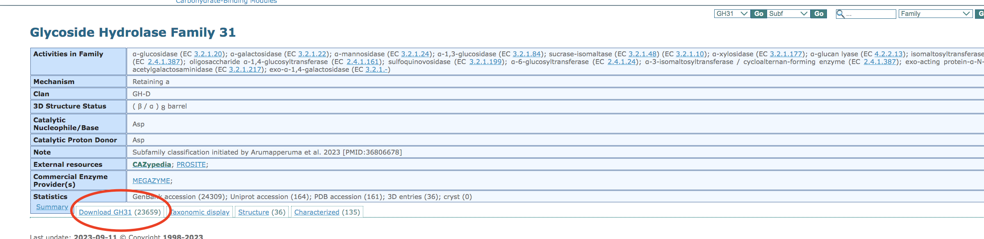
1.2 - Download and Process GH31 Family GenBank IDs
Go to the CAZy website http://www.cazy.org/
Select GH classes on CAZy database http://www.cazy.org/Glycoside-Hydrolases.html
Choose GH31 (change into your family) http://www.cazy.org/GH31.html
Find the txt file containing IDs

Slide 7
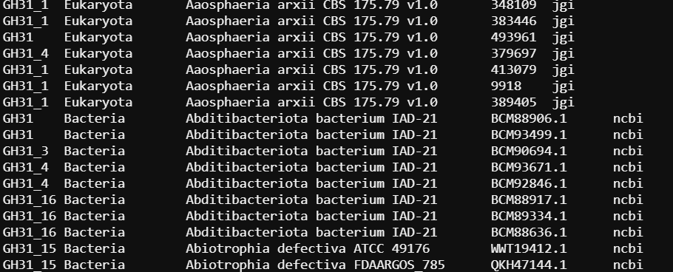
1.2 - Download and Process GH31 Family GenBank IDs
Copy the link and use the wget to download it on swan
wget http://www.cazy.org/IMG/cazy_data/GH31.txt
Use GH31.txt to get a list of genbank ids of GH31 family
less GH31.txt | grep -w ncbi | cut -f 4 > list_ids.txt
Columns in GH31.txt 1. Subfamily
2. Taxonomy: Domain
3. Organism: Species/Strain
4. Protein ID
5. Database

Slide 8
1.2 - Download and Process GH31 Family GenBank IDs
Copy the link and use the wget to download it on swan
wget http://www.cazy.org/IMG/cazy_data/GH31.txt
Use GH31.txt to get a list of genbank ids of GH31 family
less GH31.txt | grep -w ncbi | cut -f 4 > list_ids.txt
Remove the redundant IDs
cat list_ids.txt | sort | uniq > uniq_list_ids.txt
You will get 26863 unique ids in GH31
wc -l uniq_list_ids.txt

Slide 9
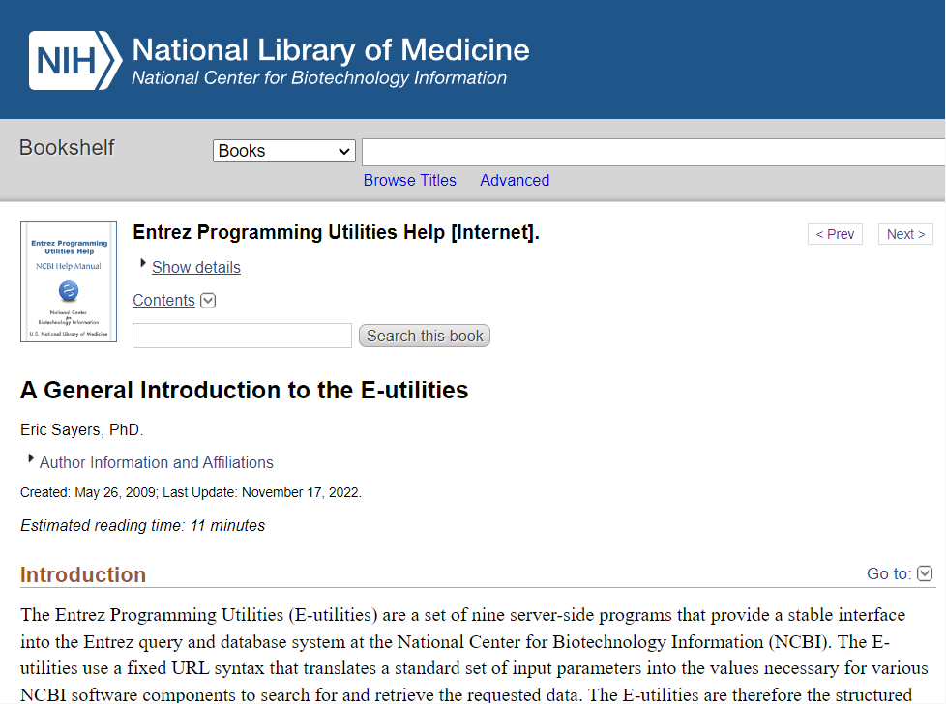
1.3 - Automating NCBI Data Retrieval with E-utilities and API Keys
The Entrez Programming Utilities (E-utilities) are server-side tools for automating queries and retrieving data from NCBI
NCBI has provided API keys that offer enhanced levels of supported access to the E-utilities
https://www.ncbi.nlm.nih.gov/books/NBK25497/
https://www.ncbi.nlm.nih.gov/books/NBK179288/

Slide 10
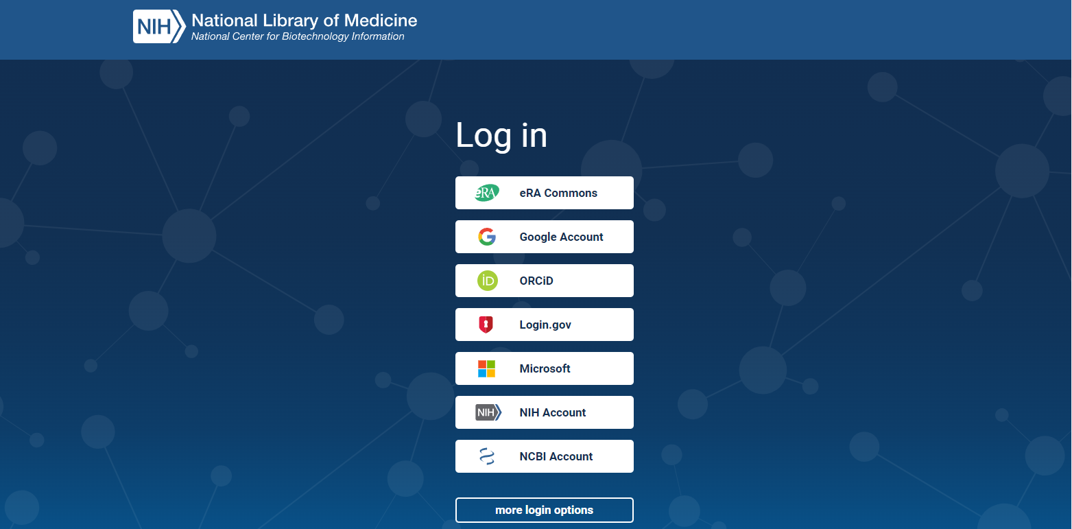
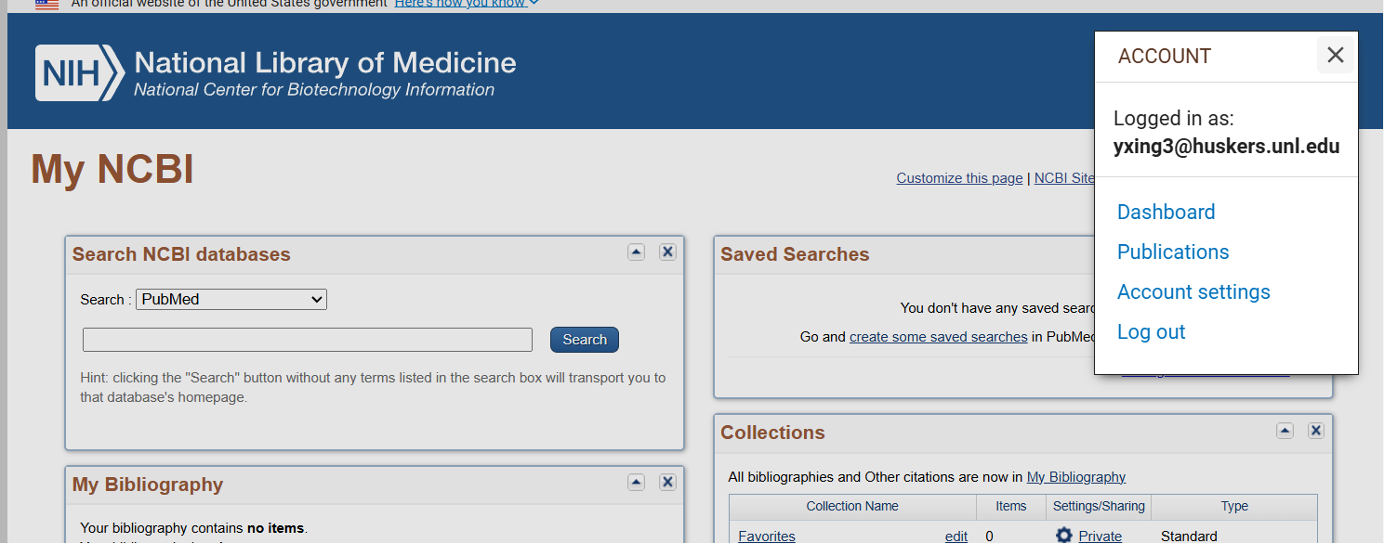
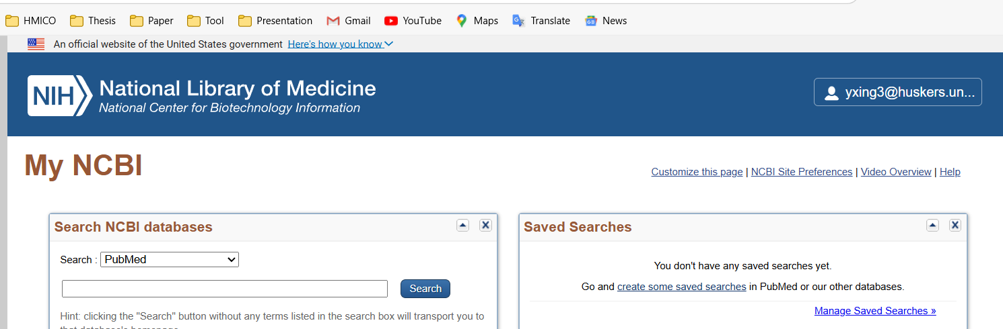
1.3 - Automating NCBI Data Retrieval with E-utilities and API Keys
Creating an NCBI Account (Recommended to Use Your UNL Account) https://account.ncbi.nlm.nih.gov/
Then go to the “Account settings”
Find your API key in the end.

Slide 11
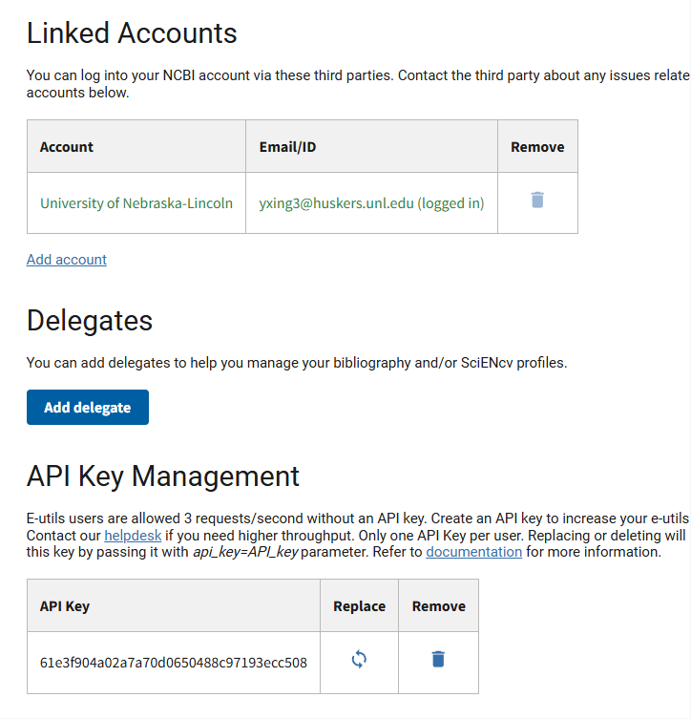
1.3 - Automating NCBI Data Retrieval with E-utilities and API Keys
Creating an NCBI Account (Recommended to Use Your UNL Account) https://account.ncbi.nlm.nih.gov/
Then go to the “Account settings”
Find your API key in the end.

Slide 12
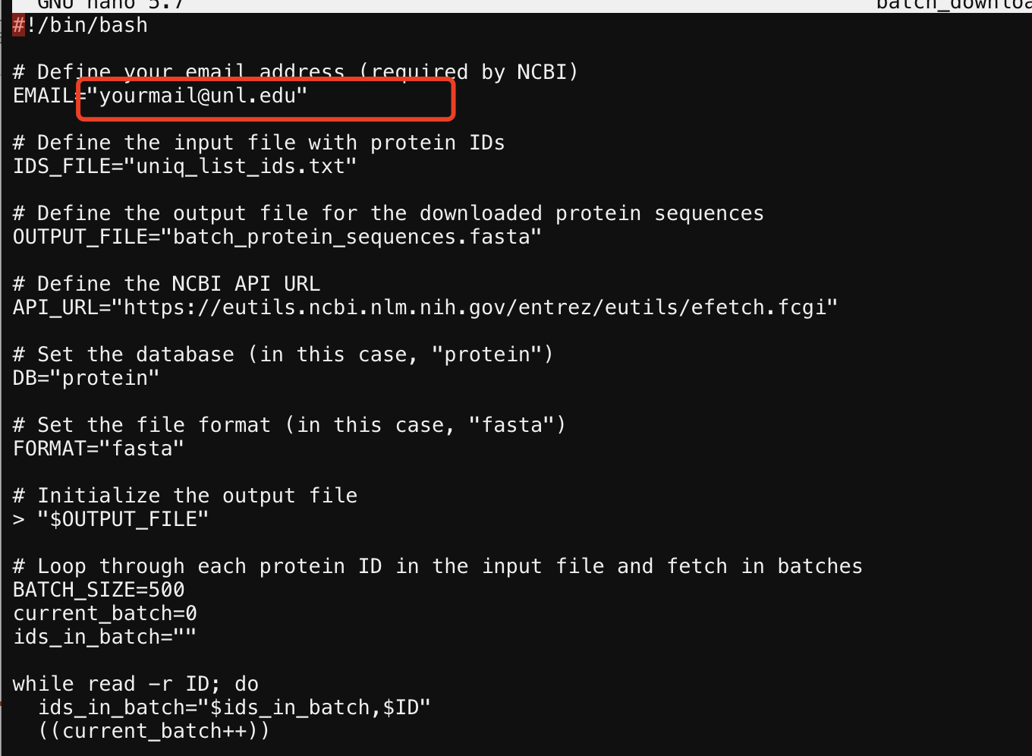
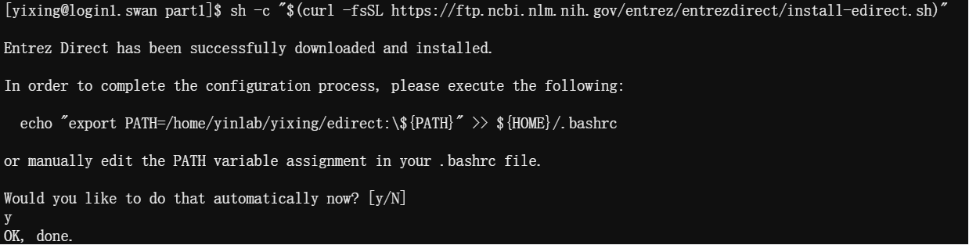
Run the following command:
sh -c "$(curl -fsSL https://ftp.ncbi.nlm.nih.gov/entrez/entrezdirect/install-edirect.sh)"
(Type y and click enter when it asks you to do it)
And use this command to set your NCBI API key
export NCBI_API_KEY=your_API_KEY
cp ../course-project-1-Subfamily-classification-of-glycoside-hydrolase-family/batch_download_protein_seqeunces.sh .
nano batch_download_protein_seqeunces.sh
Revise to change email address
The uniq_list_ids.txt file will be processed for this sh script

Slide 13
After that
bash batch_download_protein_seqeunces.sh
It takes ~30mins to downloading data.
26862 ids were found and downloaded.
Finally you get a file called “batch_protein_sequences.fasta”.
“batch_protein_sequences.fasta”: protein sequences downloaded from NCBI using GenBank IDs extracted from the GH31.txt file on the CAZy website

Slide 14
Part II Domain annotation
Create your part2 folder

Slide 15
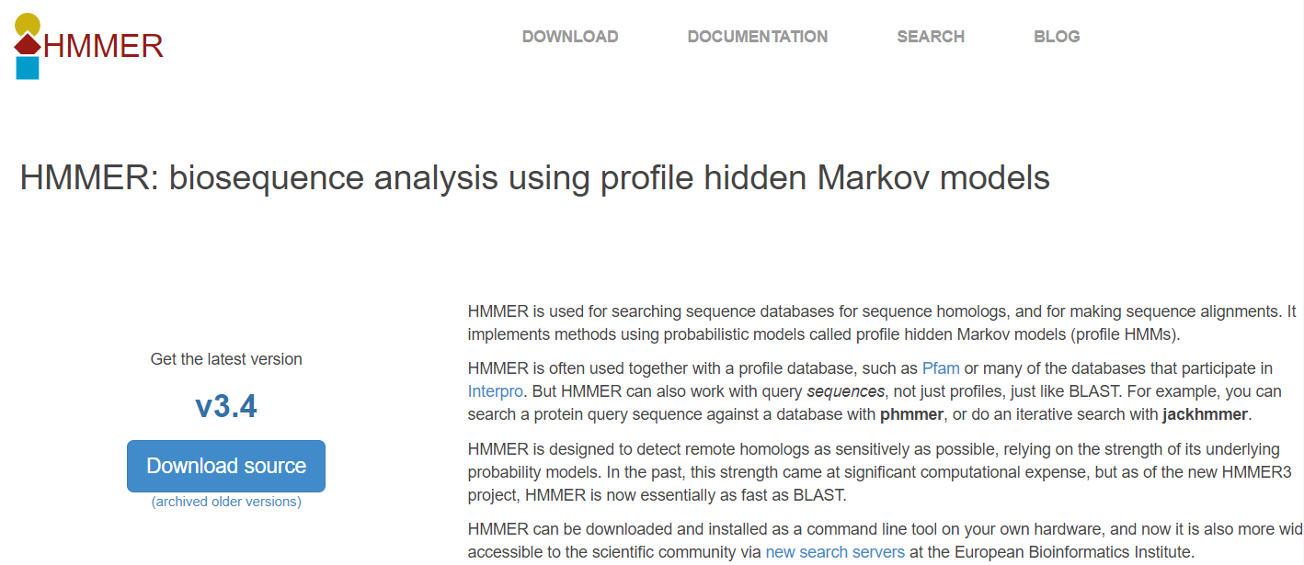
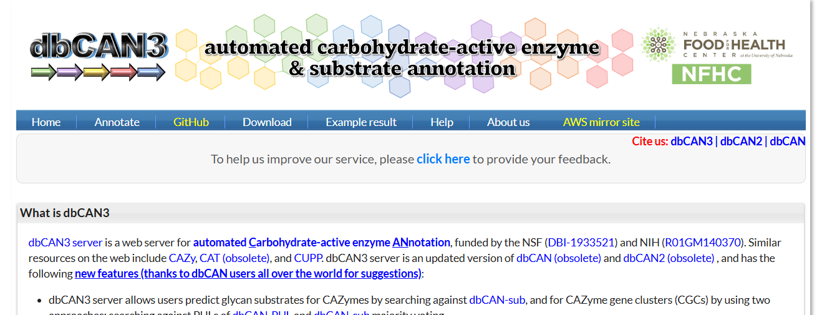
2.1 - Domain Annotation of Protein Sequences Using HMMER and dbCAN
HMMER is used for searching sequence databases for sequence homologs, and for making sequence alignments. HMMER is often used together with a profile database, such as Pfam.
dbCAN: a database for CAZyme family-specific signature domains.
https://bcb.unl.edu/dbCAN2/

Slide 16
2.1 - Domain Annotation of Protein Sequences Using HMMER and dbCAN
Steps to Run dbCAN CAZyme Annotation
https://bcb.unl.edu/dbCAN2/download/Databases/dbCAN-old@UGA/readme.txt
Go to the website:
https://bcb.unl.edu/dbCAN2/download/Databases/dbCAN-old@UGA/
Use wget to download “dbCAN-fam-HMMs.txt” and “hmmscan-parser.sh”
Use module load to activate hmmer on swan.
ml hmmer/3.3
hmmbuild -h #To check if it works or not.

Slide 17
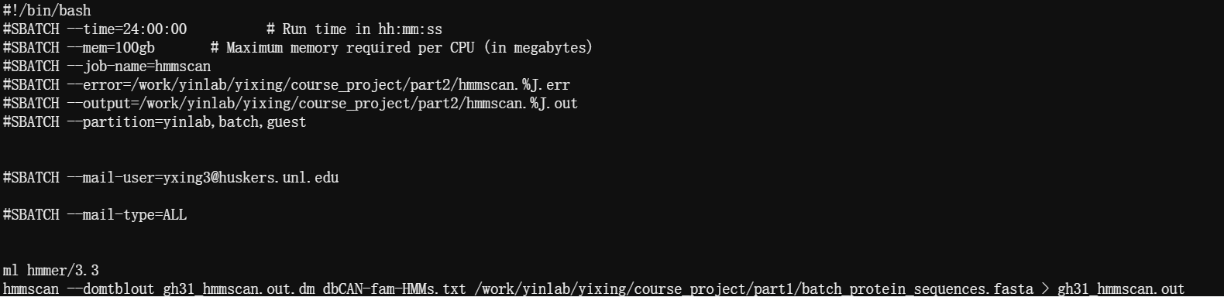
Then prepares the HMM database for faster searches:
hmmpress dbCAN-fam-HMMs.txt
cp ../course-project-1-Subfamily-classification-of-glycoside-hydrolase-family/hmmscan_run.slurm .
nano hmmscan_run.slurm
Edit it using your own info.
Try smaller mem if the waiting time is too long.
Set error and output with the same path (in your part2 folder).
Add email to remind you when it start/stop.
Remember where you have your GH31 protein sequence files.
It takes ~4hrs
Notes:
The hmmpress dbCAN-fam-HMMs.txt command compresses and indexes the HMM database to optimize it for faster and more efficient searches using HMMER tools like hmmscan and hmmsearch.

Slide 18
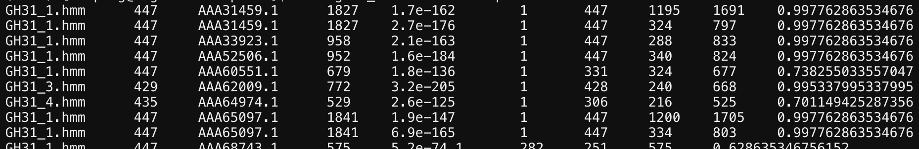
Run the following commands to make the result readable:
sh hmmscan-parser.sh gh31_hmmscan.out.dm > gh31_hmmscan.out.dm.ps
And extract the final modules by filtering with E- Value <1e-15 and coverage cut off >0.35
cat gh31_hmmscan.out.dm.ps | awk '$5<1e-15&&$10>0.35' > gh31_hmmscan.out.dm.ps.stringent
Columns in yourfile.out.dm.ps: 1. Family HMM 2. HMM length 3. Query ID 4. Query length 5. E-value: the similarity between the query sequence and the HMM family
( Lower E-values mean higher similarity and more significant matches) 6. HMM start 7. HMM end 8. Query start 9. Query end
10. Coverage: the proportion of the HMM model that aligns with the query sequence, indicating how much of the model is covered by the match
Notes:
HMM model family: These families are statistical models built from many similar sequences, capturing the characteristic features of the family. Each family represents a group of proteins/domains that share similar structure or function.
Family HMM: The HMM family that the query sequence matched (the protein family or domain represented by the HMM).
HMM length: The length of the HMM model in amino acids or nucleotides.
Query ID: The identifier of the query sequence being analyzed.
Query length: The total length of the query sequence in amino acids or nucleotides.
E-value: A statistical value indicating the similarity between the query sequence and the HMM family. Lower E-values mean higher similarity and more significant matches.
HMM start: The start position in the HMM model where the match begins.
HMM end: The end position in the HMM model where the match finishes.
Query start: The start position in the query sequence where the match begins.
Query end: The end position in the query sequence where the match finishes.
Coverage: The proportion of the HMM model that aligns with the query sequence, indicating how much of the model is covered by the match.

Slide 19
Part III Domain extraction
Create your part3 folder

Slide 20
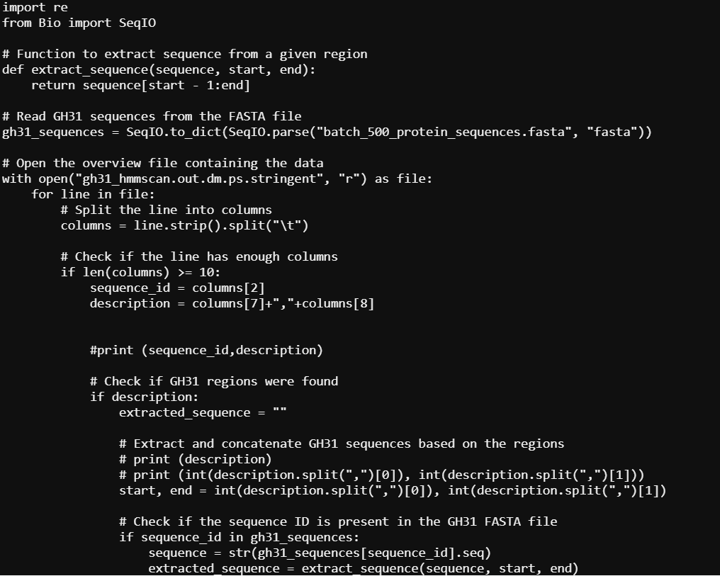
3.1 - Extracting GH31 Domains Using Python and SeqKit
First activate the biopython.
ml biopython/py311/1.81
cp ../course-project-1-Subfamily-classification-of-glycoside-hydrolase-family/filter_modules_24oct2024.py .
cp ../part1/batch_protein_sequences.fasta .
cp ../part2/gh31_hmmscan.out.dm.ps.stringent .
nano filter_modules_24oct2024.py
python filter_modules_24oct2024.py > extracted_domains.faa
ml seqkit
seqkit sample -p 0.2 extracted_domains.faa -o random_selected_extracted_domains_02.faa
change the batch_protein_sequences.fasta and the family name in filter_modules_24oct2024.py

Slide 21
Workflow

Slide 22



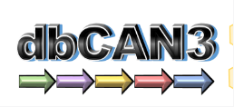

Workflow1. Subfamily Classification: Data Preparation, Annotation, and Domain Extraction
GH31 protein sequences
(batch_protein_sequences.fasta)
Data download
E- Value < 1e-15
coverage >0.35
Domain annotation
filtered file containing high-confidence matches
(gh31_hmmscan.out.dm.ps.stringent)
Domain extraction
extracted GH31 domain sequences
(random_selected_extracted_domains_02.faa)
filter_modules_24oct2024.py
random subset (20% )
subfamily classification
Notes:
Last week, I mainly demonstrated how to run each command step-by-step. Today, I’ll provide an overview of the project workflow and explain the purpose of each step in the process.

Slide 23
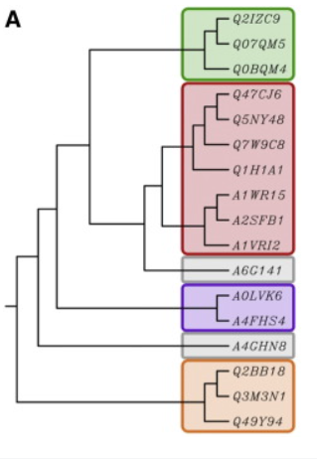
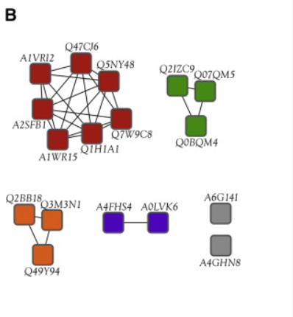
Classification Method Introduction:
Method | Phylogenetic Trees | Sequence Similarity Networks (SSNs)
Purpose | Shows evolutionary relationships between sequences | Visualizes sequence similarity within protein families
Visualization | Complex, hierarchical structure; can be hard to interpret for large datasets | Nodes (proteins) connected by edges based on similarity; easy overview
Alignment | multiple sequence alignment (MSA) | pairwise sequence similarity
Scalability | Computationally intensive; challenging for large datasets | Computationally efficient; scales well with dataset size
Best For | Detailed evolutionary insights | Quick functional clustering and relationship overview
Scalability Challenge: As the CAZy database expands, it will be increasingly difficult to generate accurate subfamily phylogenies for most families.
https://doi.org/10.1074/jbc.RA119.010619
https://doi.org/10.1016/j.bbapap.2015.04.015
Notes:
In contrast to MSA-based phylogenies, SSNs are based on all-versus-all pairwise local sequence alignments, the computational requirements of which scales linearly with the number of sequences and are easily amenable to parallelization.

Slide 24
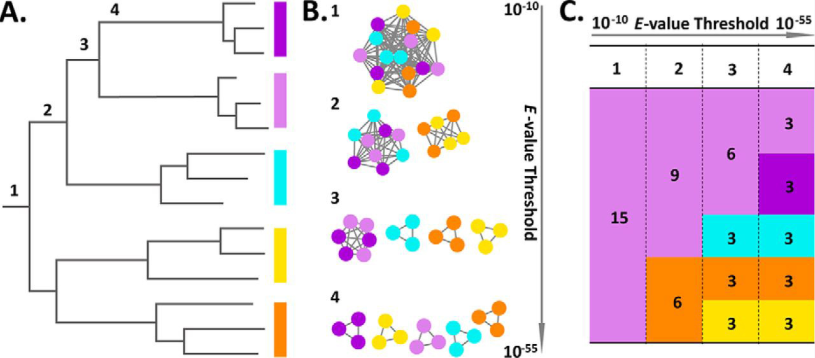
Classification Method Introduction:
15 sequences to be classified into subfamilies illustrates the relationships between distinct representation and analysis
Number 1–4 indicate four hypothetical subfamily classifications
A. Evolutionary tree: Subfamily delineation consists of drawing a vertical line (below numbers 1–4) and making a family for each outcoming branch.
B. SSN connection graph: SSNs with sequences represented as nodes (circles) and all pairwise sequence relationships (alignments) above a defined E-value threshold indicated with edges (lines).
At increased thresholds (numbers 1–4), the connected components break up into an increasing number of subcomponents, representing putative subfamily delineations.
C. SSN tabular summary: Each column (numbers 1–4 for each E-value threshold, separated by a vertical dashed line) depicts a distinct subfamilization and displays the number of clusters/subfamilies as colored boxes and the number of members/sequences in each cluster/subfamily.
https://doi.org/10.1074/jbc.RA119.010619
Notes:
In contrast to MSA-based phylogenies, SSNs are based on all-versus-all pairwise local sequence alignments, the computational requirements of which scales linearly with the number of sequences and are easily amenable to parallelization.

Slide 25
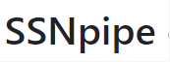
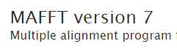

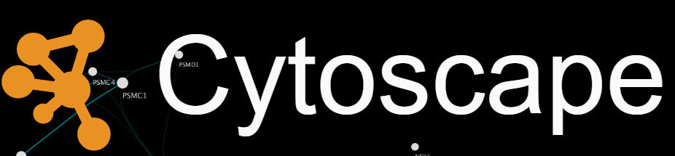

Workflow2. Subfamily Classification Using SSNs and Phylogenetic Analysis
Subfamily Classification
Sequence Similarity Networks (SSNs) Creation
Phylogenetic Analysis
Perform pairwise alignments
Multiple Sequence Alignment
Apply E-value filtering
Phylogenetic Tree Construction
Visualize networks
Tree Visualization

Slide 26
Part IV Sequence similarity networks (SSNpipe)
Create your part4 folder
https://github.com/MiguelMSandin/SSNetworks

Slide 27
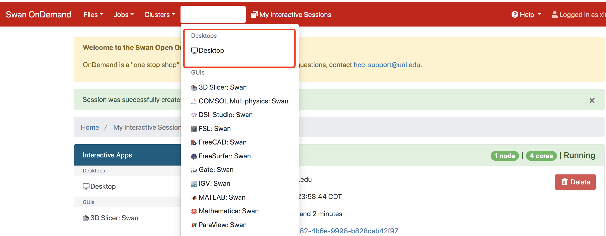
4.1 - Setup and Execution of SSNpipe
Create the part4 folder and use wget to download :
wget https://github.com/ahvdk/SSNpipe/releases/download/v.1.0-beta/ssnpipe_unix.tar.gz
tar -xvf ssnpipe_unix.tar.gz
Go to ondemand and click the “Interactive Apps”.
Set as the next slide.

Slide 28
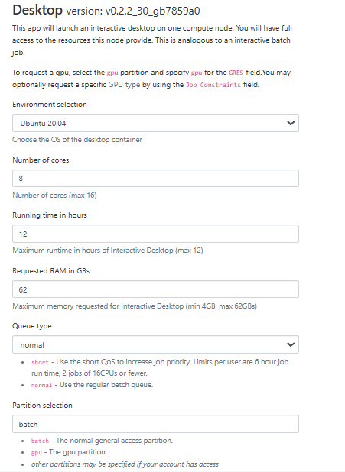
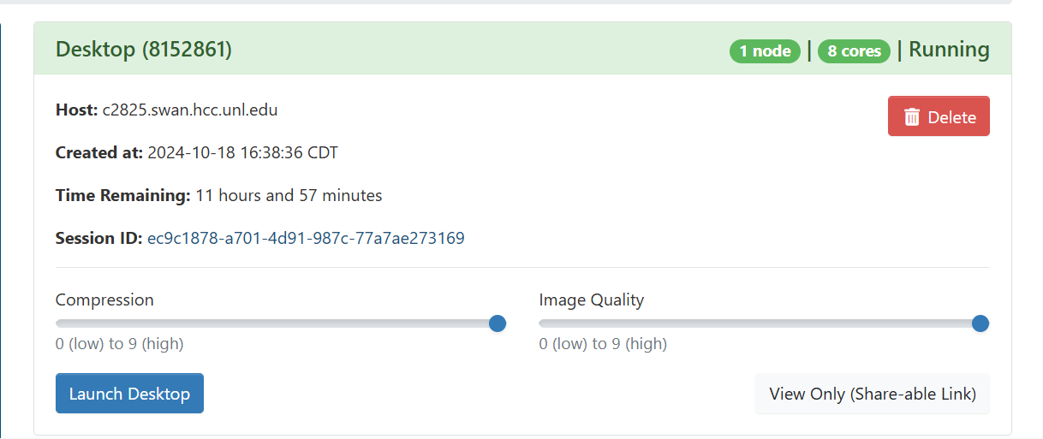


Slide 29
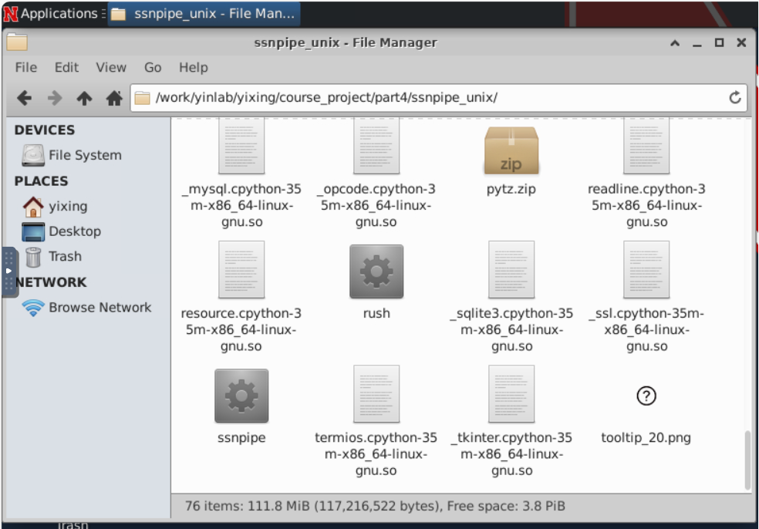
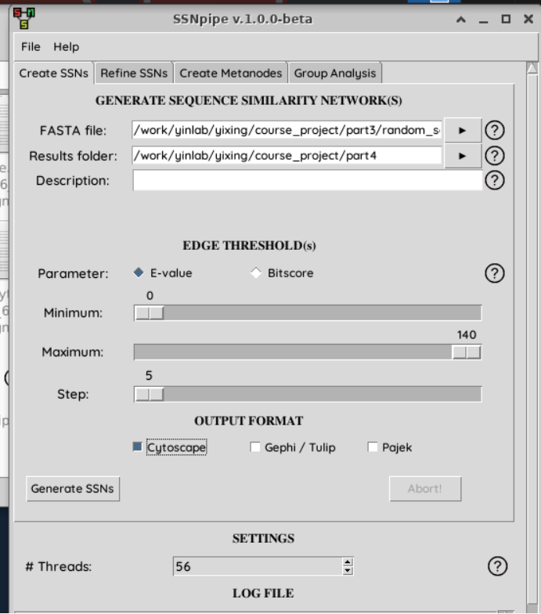
4.2 - Setup and Execution of SSNpipe - Create SSNs
Click the file manager and change the path into part4 (Don’t use copy paste here).
Move to the ssnpipe folder.
Click the SSNpipe (GUI tool).
The FASTA file will use the random_selected_extracted_domains_02.faa, and choose part4 folder as the results folder.
E-value: Minimum: 0 Maximum: 140 Steps: 5
Click on Cytoscape and Generate SSNs, the program will run for a few hours depending on the database size and computational power.
It takes about 40 mins

Slide 30
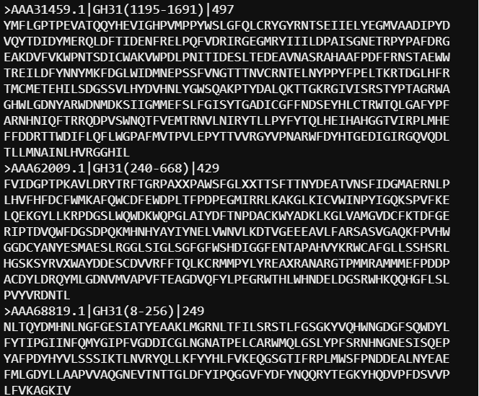
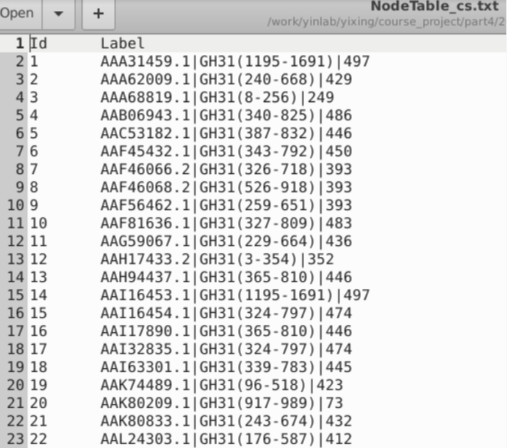
4.2 - Setup and Execution of SSNpipe - Create SSNs
Input: random_selected_extracted_domains_02.faa
Output:
1. NodeTable_cs.txt
sequence id|start end |extracted sequence length
Node ID sequence id|start end |extracted sequence length

Slide 31
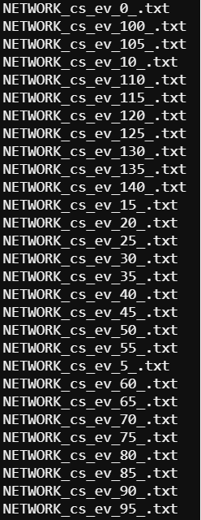
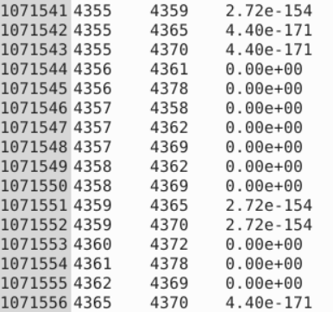
4.2 - Setup and Execution of SSNpipe - Create SSNs
Output:
2. NETWORK_cs_ev_XX_.txt
Node ID
E-value
Lower E-values indicate more significant matches, with values close to zero suggesting a highly relevant match.
E-value of 1e-140 (or 10^-140) is extremely low, meaning the likelihood that this match occurred by chance is almost negligible. This suggests a very high similarity between the query sequence and the target, making the alignment result statistically significant.

Slide 32
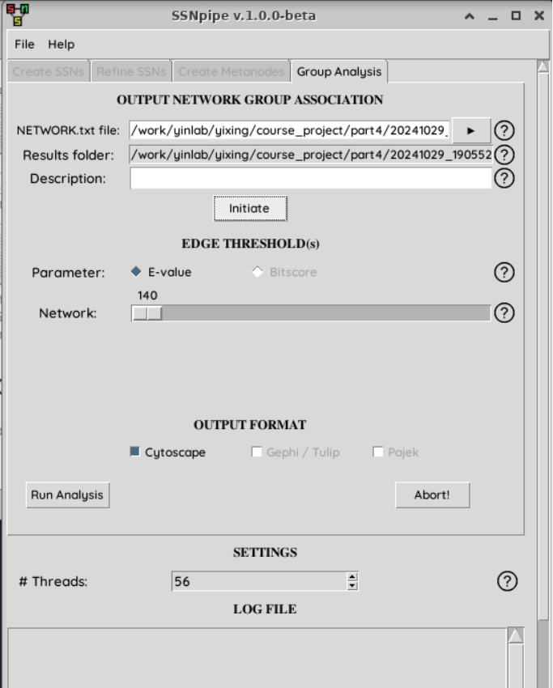
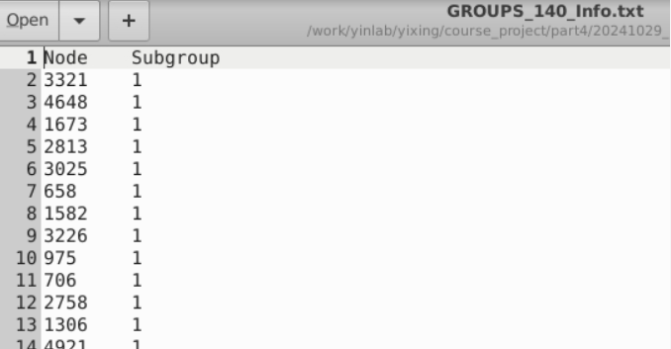
4.3 - Setup and Execution of SSNpipe - Group Analysis
Generate Group Analysis files from the 4th tab.
The NETWORK_cs_ev_XX_.txt will be the input
Click on Initiate and Run Analysis, the program will run for a few hours depending on the database size and computational power.
Output:
1. GROUPS_XXX_info.txt

Slide 33
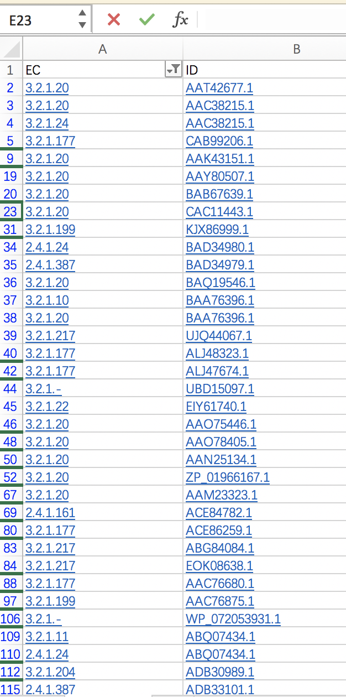
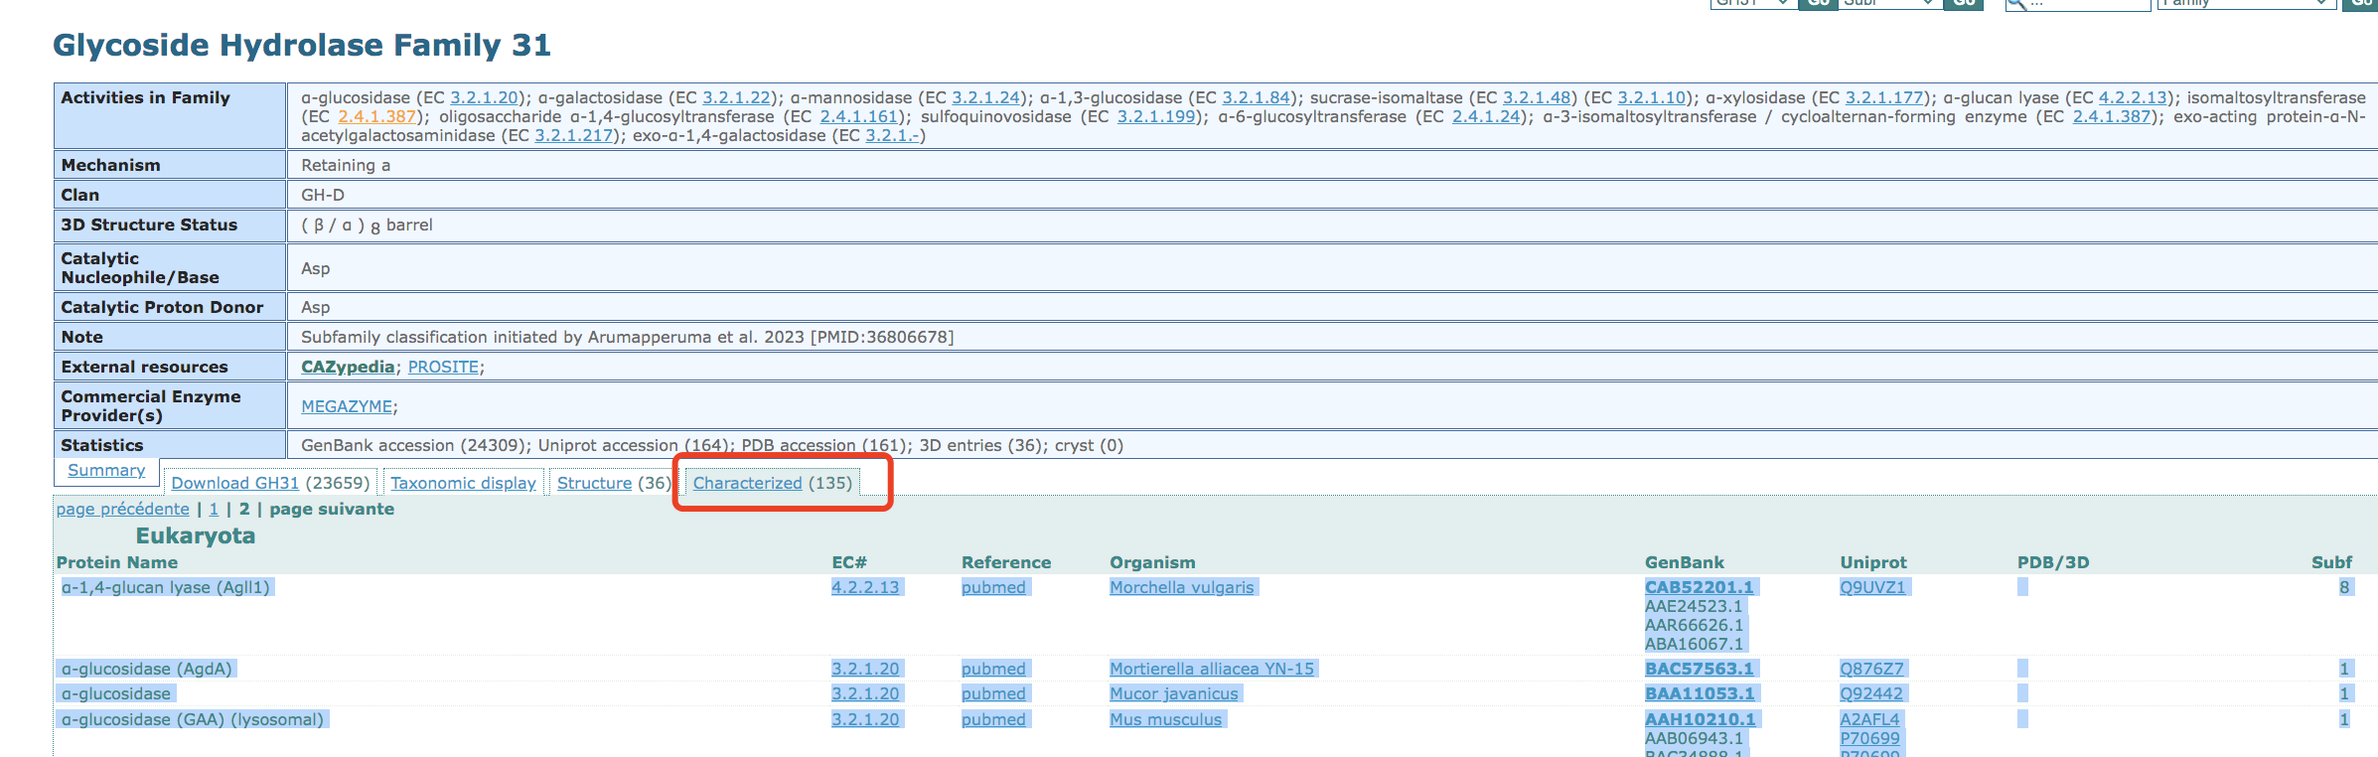
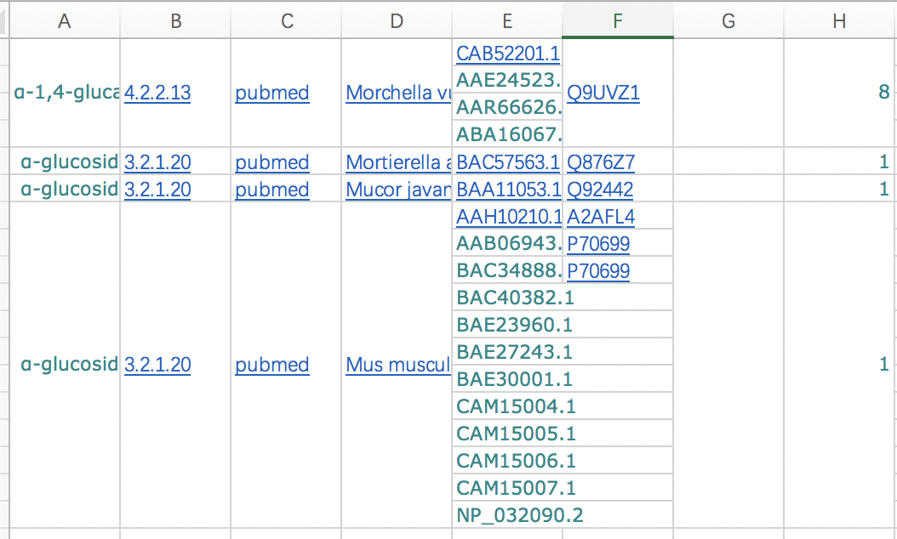
4.4 - Gathering Characterized Genbank IDs and EC Numbers from CAZy
Go to the CAZy family page to get all characterized IDs.
Tabular column page will be shown.
Copy the Characterized IDs, EC numbers from the page and paste them in Excel and select only the IDs which only have hyperlinks (Characterized by CAZy) and make a list.
Copy those in the excel and revise it then use nano to make a txt file:
*There are some Genbank ID with multiple ECs, don’t forget to check, and keep all.

Slide 34
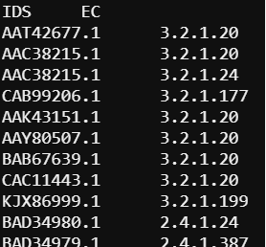
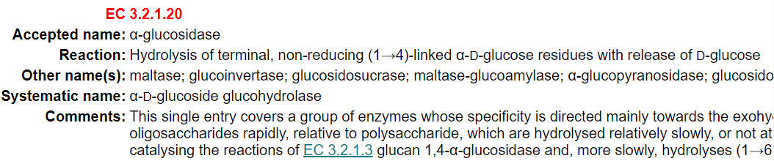
4.4 - Gathering Characterized Genbank IDs and EC Numbers from CAZy
Finally get this result: Name is “Characterized_ids_24oct2024.txt” (name could be changed but you also need to fix the program later).
The first row is IDS/EC
Enzyme Commission (EC) Number Classification
EC number is a classification system based on the chemical reactions that these proteins catalyze. It was developed by the International Union of Biochemistry and Molecular Biology (IUBMB)
First Number: The type of reaction or enzyme class. Ex: EC 3: Hydrolases
Second and third numbers: Enzyme subclass and sub-subclass
Fourth Number: Enzyme identification

Slide 35
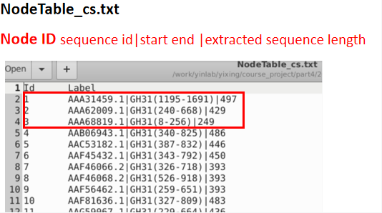
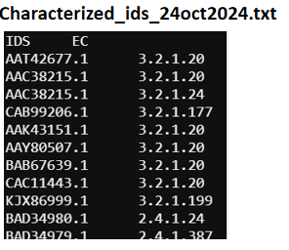
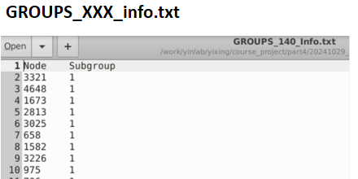
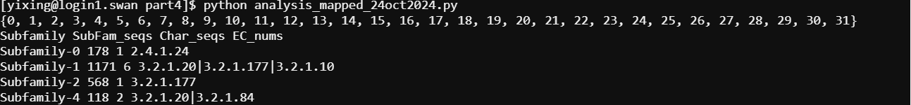
4.4 - EC-Number Mapping for Subfamily Classification
You will use NodeTable_cs.txt, GROUPS_XXX_info.txt, Characterized_ids_24oct2024.txt
cp ../course-project-1-Subfamily-classification-of-glycoside-hydrolase-family/analysis_mapped_24oct2024.py your_result_folder
cp ../part3/Characterized_ids_24oct2024.txt your_result_folder
nano analysis_mapped_24oct2024.py
python analysis_mapped_24oct2024.py

Slide 36
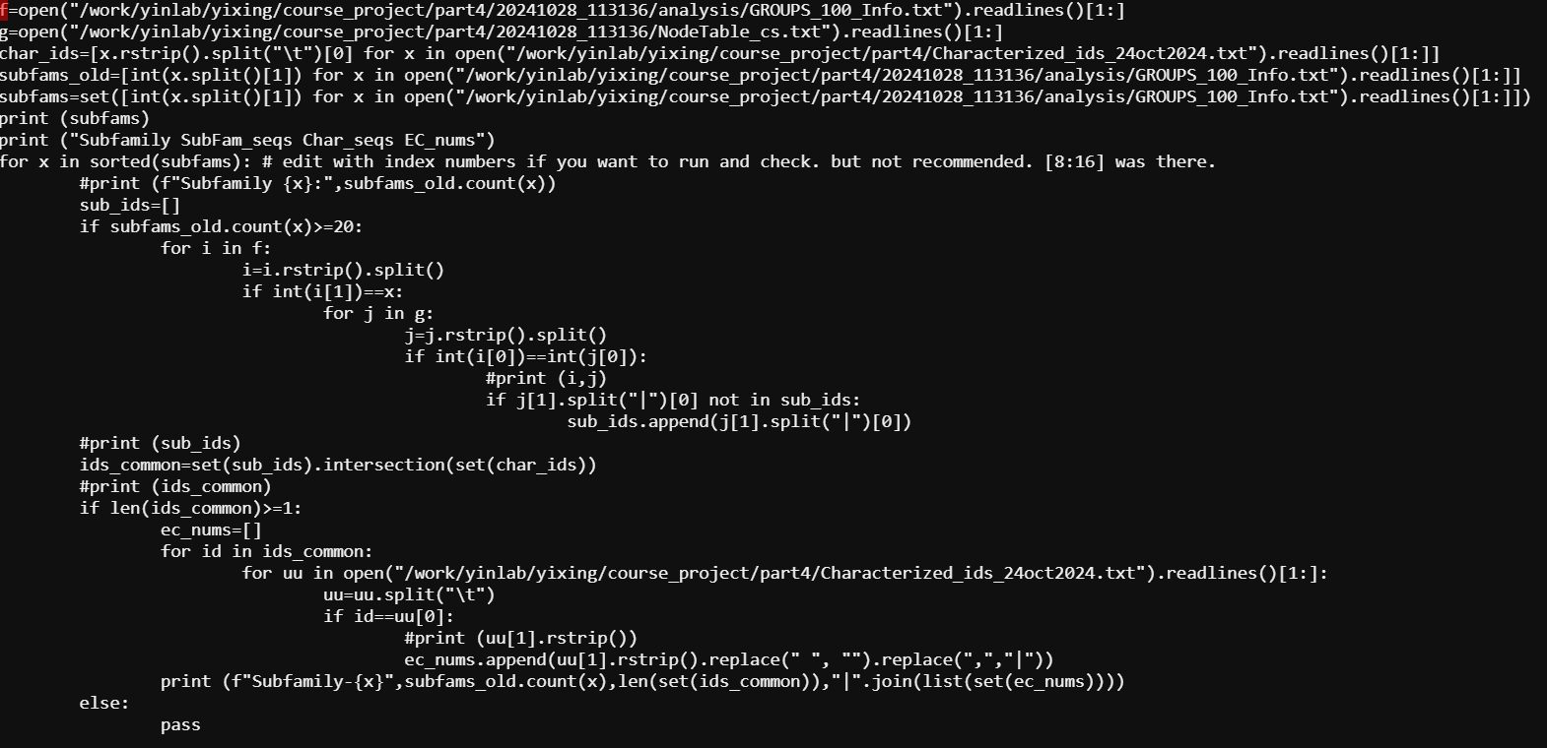
4.4 - EC-Number Mapping for Subfamily Classification
You will use NodeTable_cs.txt, GROUPS_XXX_info.txt, Characterized_ids_24oct2024.txt
cp ../course-project-1-Subfamily-classification-of-glycoside-hydrolase-family/analysis_mapped_24oct2024.py your_result_folder
cp ../part3/Characterized_ids_24oct2024.txt your_result_folder
nano analysis_mapped_24oct2024.py
python analysis_mapped_24oct2024.py
You need revise those names (from SSNpipe).

Slide 37
Part V Cytoscape Visualization
Do not need an extra folder

Slide 38

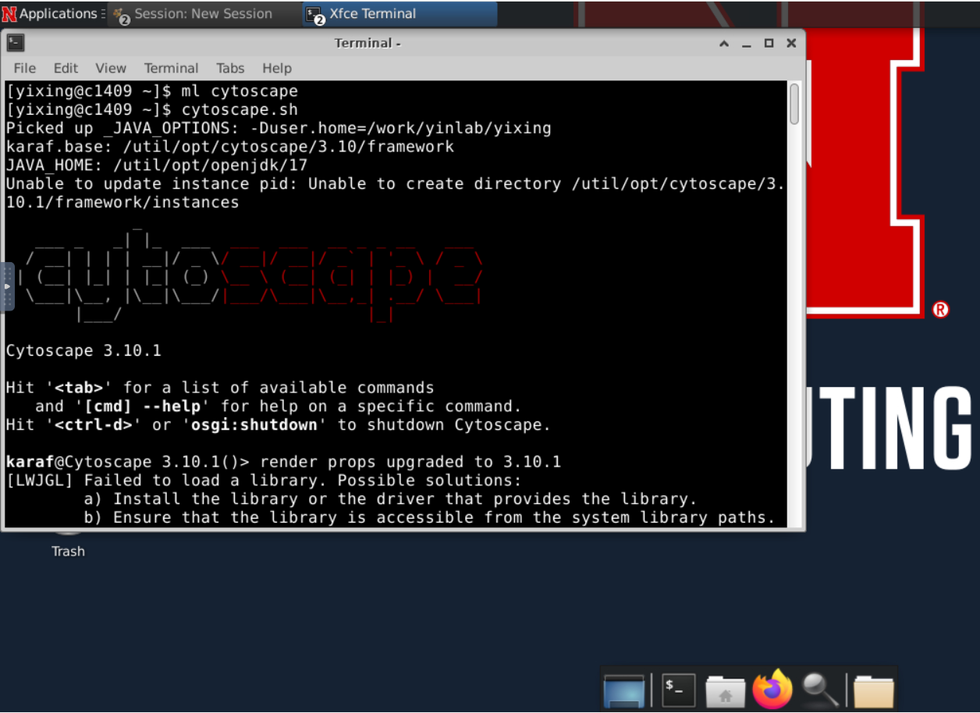
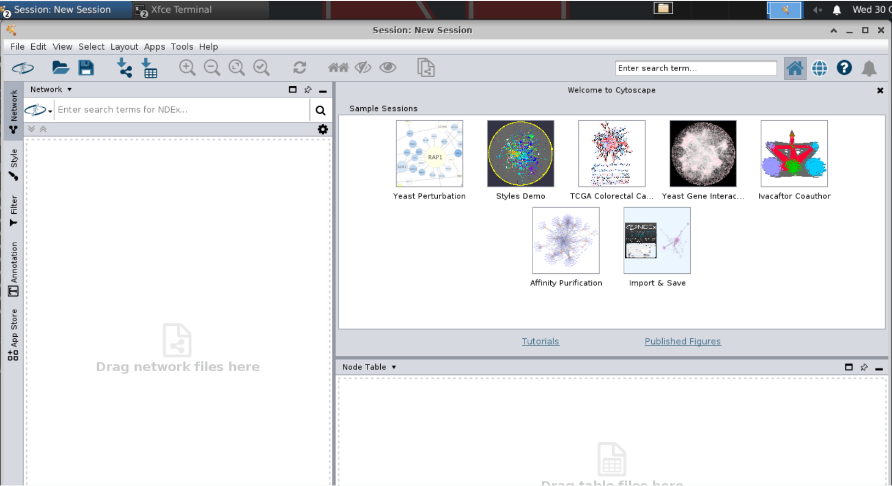
5.1 - Loading and Organizing Network in Cytoscape
Using the desktop and click the terminal on the left of “Applications”
Type: ml cytoscape/3.10
cytoscape.sh

Slide 39
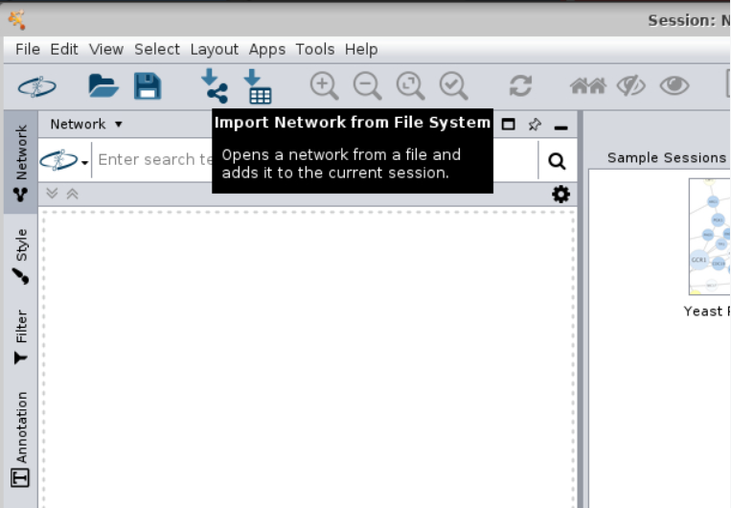

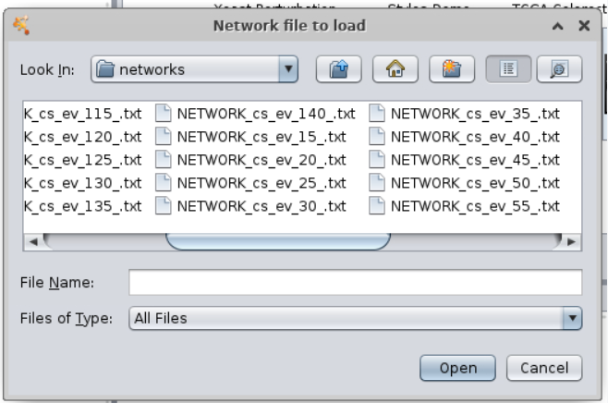
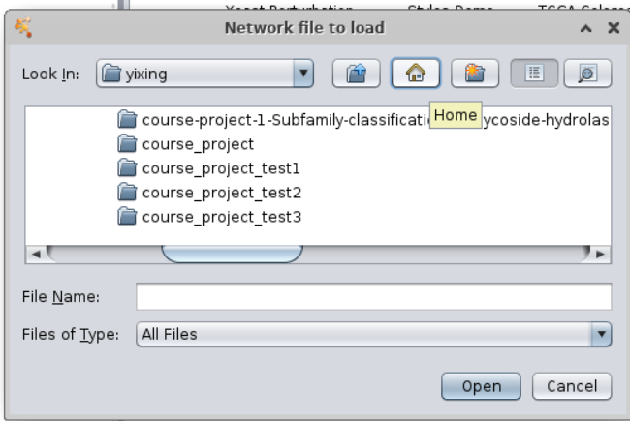


5.1 - Loading and Organizing Network in Cytoscape
Loading input files: NETWORK_cs_ev_XX_.txt, GROUPS_XXX_info.txt, NodeTable_cs.txt
*find your network file and click open
Click the to import NETWORK_cs_ev_XX_.txt
Click the to import GROUPS_XXX_info.txt, NodeTable_cs.txt

Slide 40


5.1 - Loading and Organizing Network in Cytoscape
NodeTable will generate in Cytoscape

Slide 41


5.1 - Loading and Organizing Network in Cytoscape
Use a yFiles Organic layout from the layout panel. (Install if not available)
Check different nodes (proteins) and subfamilies (clusters), how they are aligned, etc.
Modified colors based on the connected nodes and subfamilies.
Click style icon and modify the fill color.

Slide 42



Export the network to an Image or PDF
Searching the Characterized IDs in a network
Use the top right search box in the Cytoscape to find out the characterized to mark them differently.
Search format: name:YL*
Example search: name:BBM21771.1*
Export the network to an Image or PDF
Here, we have selected the query "BBM21771" This query has 1 node and 25 edges. All are highlighted here, which can be colored seperatly using the Style on the left panel.

Slide 43
Part VI Phylogenentic Analysis
Create your part6 folder

Slide 44



6.1 - Random Sampling for Phylogenetic Analysis
Purpose: Evaluate how well the SSN clusters (subfamilies) match phylogenetic classification.
Use a python program to select random 30 sequences from each subfamily
cp ../course-project-1-Subfamily-classification-of-glycoside-hydrolase-family/phylo_process_random_24oct2024.py .
nano phylo_process_random_24oct2024.py
python phylo_process_random_24oct2024.py > phylo_input_fasttree_100.fasta
Check what are needed for the python program and change the files pathway random_selected_extracted_domains_02.faa analysis/GROUPS_XXX_Info.txt Characterized_ids_24oct2024.txt

Slide 45

6.2 - MAFFT Job Submission Script for Phylogenetic Analysis
#!/bin/bash
#SBATCH --job-name=mafft_job
#SBATCH --output=mafft_output_%j.txt
#SBATCH --error=mafft_error_%j.txt
#SBATCH --nodes=1
#SBATCH --ntasks-per-node=10
#SBATCH --mem=50G
#SBATCH --time=48:00:00
#SBATCH --partition=guest,batch
#SBATCH --mail-user=yxing3@huskers.unl.edu
#SBATCH --mail-type=ALL
module load mafft
mafft --localpair --maxiterate 1000 --genafpair --thread 10 phylo_input_fasttree_100.fasta > phylo_mafft_align_1e-100.fasta

Slide 46

6.3 - Constructing Phylogenetic Tree Using FastTree
HCC module load FASTTREE
ml fasttree/2.1
fasttree -wag -boot 100 -out tree_e-100.nwk phylo_mafft_align_1e-100.fasta
Output: tree_e-100.nwk in newick format file

Slide 47




6.4 - Phylogenetic Tree Visualization on iTOL
“tree_e-100.nwk” can be visualized using the iTOL available online. https://itol.embl.de/
Download the nwk file to your laptop and upload to itol

Slide 48

6.4 - Phylogenetic Tree Visualization on iTOL
Explore the options over the webserver and save the image for the best SSN Evalue.

Slide 49

6.5 - Using Color Ranges in iTOL for Visualizing SSN Subfamily Clustering
Create color definition files to highlight those nodes(protein) with subfamily.
In ITOL, there are multiple functions to revise the tree. https://itol.embl.de/help.cgi#functions
We will use “COLOR RANGE” function to label subfamilies in the tree. https://itol.embl.de/help/colors_styles_template.txt

Slide 50
6.5 - Using Color Ranges in iTOL for Visualizing SSN Subfamily Clustering
Purpose: to create the Color DATASET file to annotate the Subfamily from SSN
Check and change the files pathway
analysis/GROUPS_XXX_Info.txt
NodeTable_cs.txt
Characterized_ids_24oct2024.txt
grep ">" phylo_mafft_align_1e-100.fasta | cut -f1 -d'(' | sed 's/>//' > list
cp itol_color_strip.py and ec.itol_color.py to your folder
python itol_color_strip.py GROUPS_100_Info.txt NodeTable_cs.txt output.txt --id_file list
cat ../part4/Characterized_ids_24oct2024.txt | awk -v FS='\t' -v OFS='\t' '{print$1"|GH31",$2}' > ec.id.txt
python ec.itol_color.py --input ec.id.txt --output itol_ec_color.txt

Slide 51



6.5 - Using Color Ranges in iTOL for Visualizing SSN Subfamily Clustering
Download those (two outputs) on your laptop and import it into iTOL.
itol_ec_color.txt
output.txt

Slide 52



6.5 - Using Color Ranges in iTOL for Visualizing SSN Subfamily Clustering
Follow the steps to get legends.
We have two ring: subfam and EC number.

Slide 53

You could export the result as SVG/PNG file.
NOTICE:
If you don’t have a subscription account, the annotations would not be saved. Please export the result when you finish.
Sign up an account to keep the result (without annotations).

Slide 54
Part VII Other analysis
Create your part7 folder

Slide 55
Interpretation and analysis of the subfamilies based on the Phylogeny and subfamilies from the selected E-value.
Interpretation steps and protocol:
Explain each subfamily in terms of EC number, taxonomical diversity, enzyme activity and structures.
Select any one characterized ID and their EC numbers from each subfamily from the results (Output of “analysis_mapped_24oct2024.py”).
If PDB ID (Protein Data Bank, https://www.rcsb.org/) is available, take the structure, or else model them using “Swiss-model” or AlphaFold2.
Identify the common catalytic domain between each subfamily.
Use PyMol to load and visualize the structures. (Available in HCC interactive apps).

Slide 56


How to use Alaphfold to search protein structure: 1. If know the protein ID/name: https://alphafold.ebi.ac.uk/ Directly search it.
2. If it cannot be found, could try use sequence: Use FASTA tool to search: https://www.ebi.ac.uk/Tools/sss/fasta/

Slide 57

3. Try google colab: https://colab.research.google.com/github/sokrypton/ColabFold/blob/main/AlphaFold2.ipynb

Slide 58

Any Questions?
🕸️
🕸️
👻
🕸️

